Slide 1
Introduction to repl.it
CST370 – Design & Analysis of Algorithms
Dr. Byun
Computer Science

Slide 2
Programming Tool for CST370
C++ will be used in the class.
  For the programming assignment, you have to use the repl.it (https://repl.it/)
repl.it is an online integrated development environment.
  You can access it from anywhere using a web browser.
  It provides a terminal to develop a program.

Slide 3
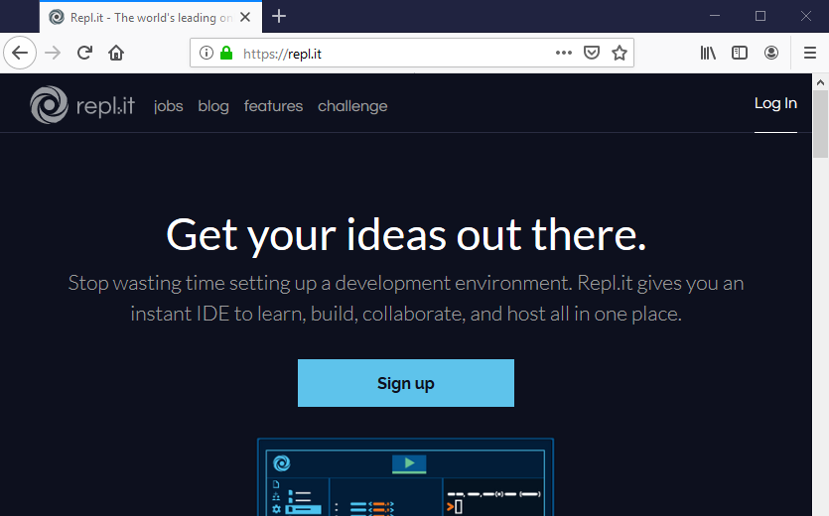
Initial Screen*
* Your initial screen may be different. But it will not be an issue.

Slide 4
Signup to Create New Account
If you already have an account in repl.it, use your current account.
However, if this is your first time, click the button “Sign up” and follow the instruction.

Slide 5
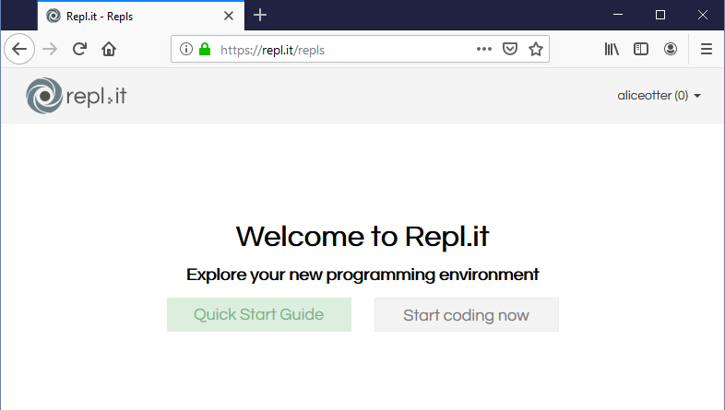
Signup to Create New Account
This is the initial screen after “Sign up”.
  Select “Start coding now”.

Slide 6
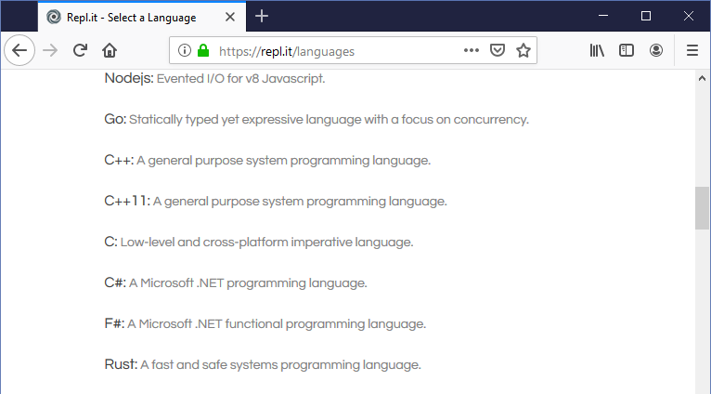
Select C++11 as your language
We use C++11 in CST370.
  Do not choose C++.

Slide 7
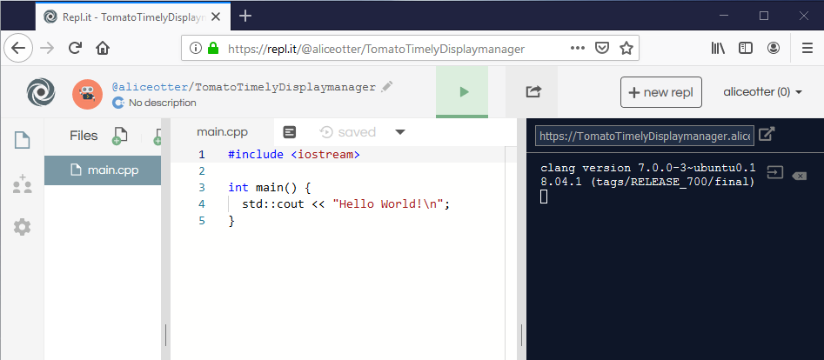
Initial Repl with HelloWorld!
You may have a first repl like below.
  Select “>” symbol to run the program.

Slide 8

New Repl Creation (1 of 3)
Select “+ new repl” to create a new repl.
Select this button.

Slide 9
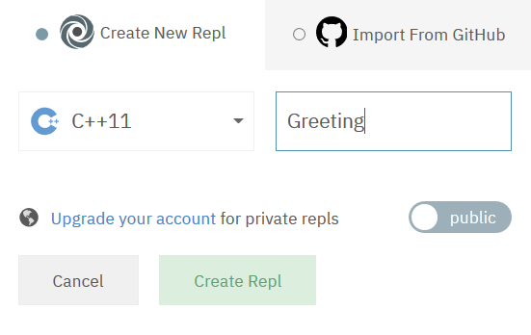
New Repl Creation (2 of 3)
Language: “C++11”.
Repl Name: “Greeting”.

Slide 10
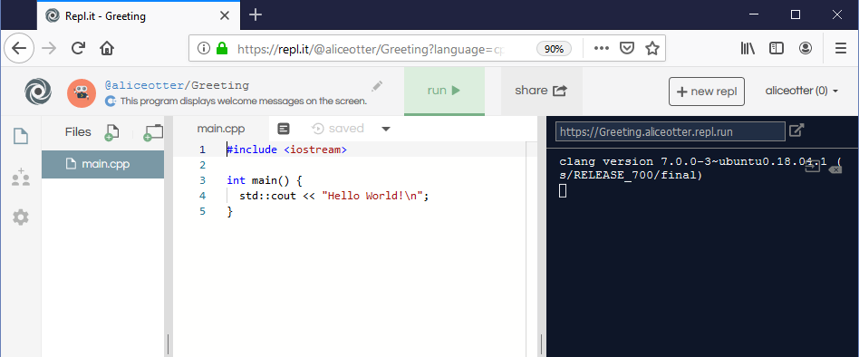
New Repl Creation (3 of 3)
Note that you have a new repl named “Greeting” like below.

Slide 11
Edit Source Code
/*
* Title: greeting.cpp
* Abstract: This program displays welcome messages on the screen.
* Author: Alice Otter [Write your name.]
* ID: 1234 [Put your choice of a four-digit number]
* Date: MM/DD/YYYY
*/
#include <iostream>
using namespace std;
int main()
{
cout << "Hi! Welcome to the class." << endl;
cout << "Data Structures and Algorithms are fun.\n";
cout << "Enjoy the class." << endl;
return 0;
}

Slide 12
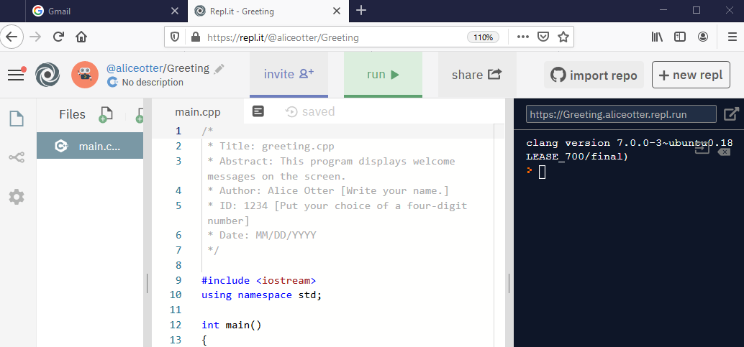
Run the program
Select “Run” button

Slide 13
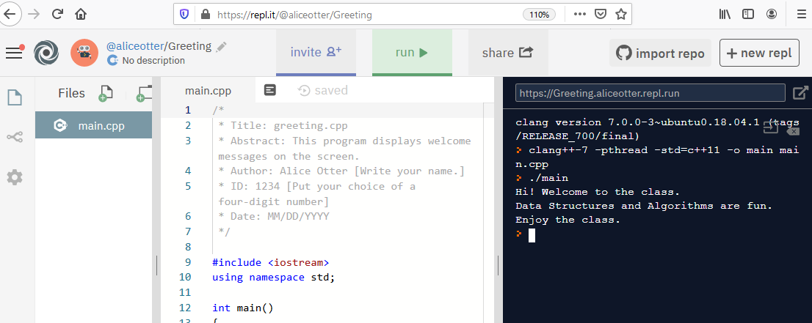
Execution Result
You can see the execution result of the program at the right window.

Slide 14
clang Compilation
Repl.it uses “clang” compiler.
  Pay attention to the compilation command.
> clang++-7 -pthread -std=c++11 -o main main.cpp
> ./main
Hi! Welcome to the class.
Data Structures and Algorithms are fun.
Enjoy the class.
>

